Slide 1
Explaining Recurrent Neural Network Predictions in Sentiment Analysis
] L. Arras, G. Montavon, K. Müller, W. Samek, Explaining recurrent neural network predictions in sentiment analysis, in: Proceedings of the 8th Workshop on Computational Approaches to Subjectivity, Sentiment and Social Media Analysis, WASSA@EMNLP 2017, Copenhagen, Denmark, 8 September, 2017, 2017, pp. 159–168

Slide 2
Layer-wise Relevance Propagation
what input features were important for reaching the final top-layer prediction.
Some of these techniques are based on the model’s local gradient information while other methods seek to redistribute the function’s value on the input variables, typically by reverse propagation in the neural network graph.

Slide 3

Gradient-based Sensitivity Analysis (SA)

Slide 4
Layer-wise Relevance Propagation (LRP)
It is based on a layer-wise relevance conservation principle, and, for a given input x, it redistributes the quantity f_{c}(x), starting from the output layer of the network and backpropagating this quantity up to the input layer.
there are two types of neural connections involved: many-to-one weighted linear connections, and two-to-one multiplicative interactions.

Slide 5
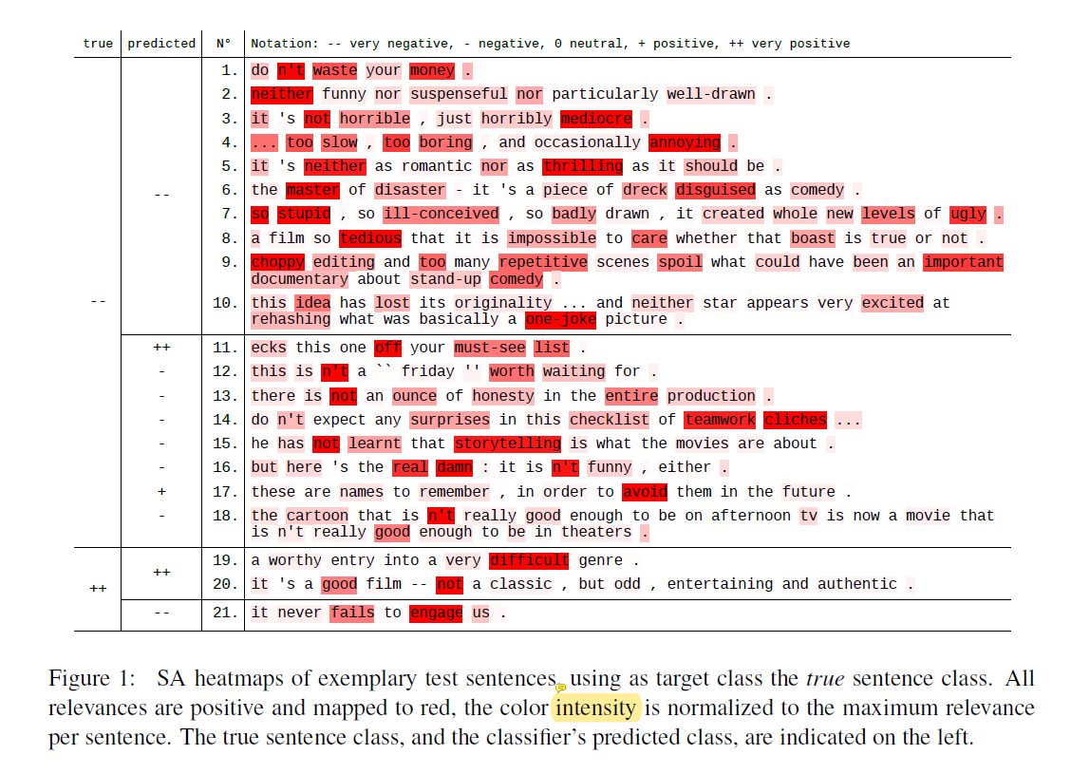

Slide 6
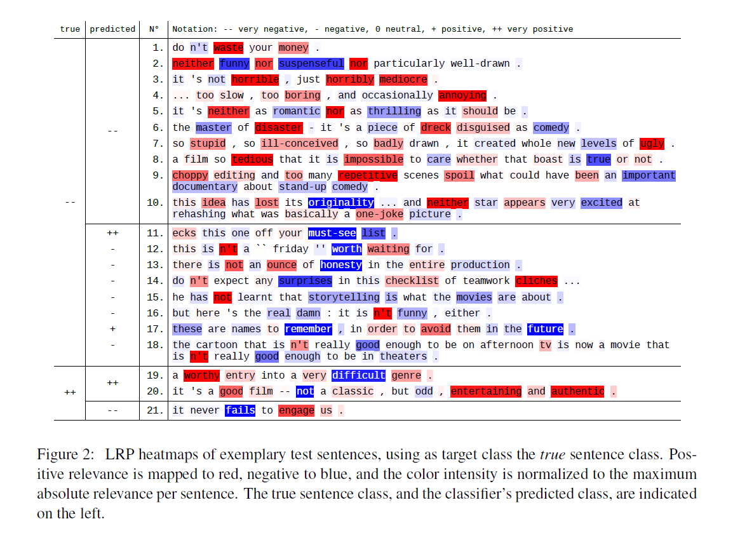

Slide 7
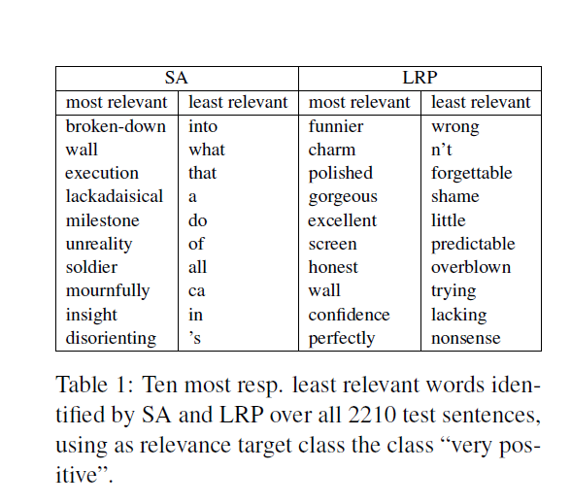

Slide 8
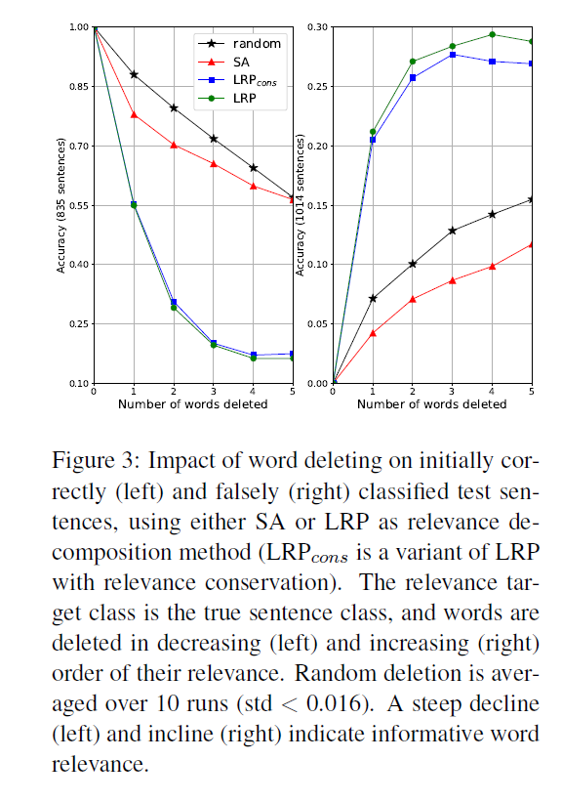

Slide 9
